Slide 1
Chemical Bonding It holds us all together

Slide 2
Chemical Bonding
Think about it … just 26 letters make up over 1 MILLION English words!!
The Periodic Table has over 100 elements – how many combinations could be created?!?!?!
- Compounds form when 2 or more atoms bond together

Slide 3
Different Properties
Think about it again … a word doesn’t necessarily sound the way each individual letter would
for example – Amy Biehl!
Likewise, chemical compounds don’t necessarily look or react the same way each individual element would ………..

Slide 4
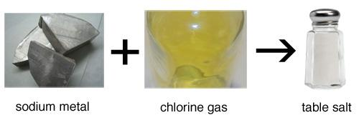
Example:
The element sodium (Na) is a silver-colored metal that reacts so violently with water that flames are produced when sodium gets wet.
The element chlorine (Cl) is a greenish-colored gas that is so poisonous that it was used as a weapon in World War I.
When chemically bonded together, these two dangerous substances form the compound sodium chloride (NaCl), a compound so safe that we eat it every day - common table salt!

Slide 5
1916: American chemist Gilbert Newton Lewis proposed that chemical bonds1916: American chemist Gilbert Newton Lewis proposed that chemical bonds are formed by the electrons. (Remember that electrons were only discovered about 20 years earlier – wow!)
Lewis observed (lots of looking at the data!) that many elements are most stable (meaning they DON’T react or bond with anything else) when they contain 8 electrons in their valence shell (outer layer). He suggested that atoms bond together to share electrons and complete their valence shells. Smart!

Slide 6
Ionic bonding
Electrons are completely transferred from one atom to another.
In the process of either losing or gaining negatively charged electrons, the reacting atoms form ions.
The oppositely charged ions are attracted to each other by electrostatic forces, which are the basis of the ionic bond.

Slide 7
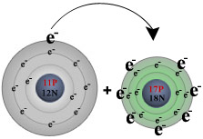
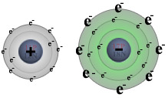
For example, during the reaction of sodium with chlorine:
sodium (on the left) loses its one valence electron to chlorine (on the right),
resulting in a positively charged sodium ion (left) and a negatively charged chlorine ion (right).

Slide 8
Some facts about ionic bonds:
1. Ionic bonds form between metals and nonmetals.
2. In naming simple ionic compounds, the metal is always first, the nonmetal second (e.g., sodium chloride).
3. Ionic compounds dissolve easily in water and other polar solvents.
4. Ionic compounds tend to form crystalline solids with high melting temperatures.

Slide 9
Covalent bonding
Electrons are shared between the atoms
Most common: two nonmetals bond together. Both of the nonmetals will want to gain electrons, so the elements involved will share electrons to try to fill their valence shells.
Example: two hydrogen atoms. Atoms of hydrogen (H) have one valence electrons in their first electron shell. Since the capacity of this shell is two electrons, each hydrogen atom will "want" to pick up a second electron.

Slide 10
Covalent Molecules
Unlike ionic compounds, covalent molecules are true molecules.
Because electrons are shared in covalent molecules, no ionic charges are formed.
So covalent molecules are not strongly attracted to one another, and so covalent molecules move about freely and tend to exist as liquids or gases at room temperature.

Slide 11
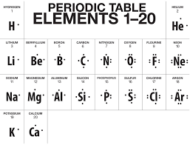
Lewis Dot Structures:
the element symbol surrounded by dots that represent the valence electrons.

Slide 12
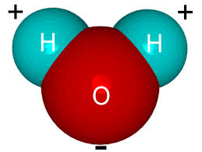
Hydrogen Bonding
A hydrogen bond is the attractive force between a hydrogen is the attractive force between a hydrogen atom (with low electronegativity) and an electronegative is the attractive force between a hydrogen atom (with low electronegativity) and an electronegative atom such as nitrogen is the attractive force between a hydrogen atom (with low electronegativity) and an electronegative atom such as nitrogen, oxygen is the attractive force between a hydrogen atom (with low electronegativity) and an electronegative atom such as nitrogen, oxygen, or fluorine.
No electrons, in-between molecules not atoms, no physical connections

Slide 13
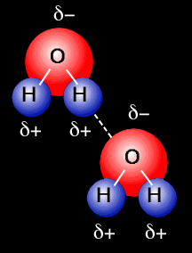
Hydrogen Bonding Example: the water molecule
Oxygen is very electronegative, so it pulls more electron (and their negative charges) towards it’s end of the molecule
Therefore each slightly positive H is attracted to another slightly negative O
Like a “mini” ionic bond!
Watch this video:
http://www.clearbiology.com/water-molecule-worksheet/

Slide 14
More about hydrogen bonds . . .
Hydrogen bonds are BETWEEN covalently bonded molecules – very different from ionic and covalent bonds!
weaker than intra-molecular bonds like covalent and ionic
hydrogen bonding is responsible for the high boiling point of water (100 °C) compared to the other similar molecules that have no hydrogen bonds. Powerful attraction!

