Slide 1
Chemical Bonding It holds us all together

Slide 2
Chemical Bonding
Think about it … just 26 letters make up over 1 MILLION English words!!
The Periodic Table has over 100 elements – how many combinations could be created?!?!?!
- Compounds form when 2 or more atoms bond together

Slide 3
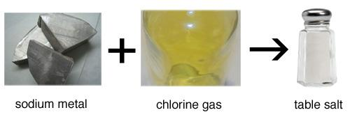
Compounds are very different than the elements that make them!
The element sodium (Na) is a silver-colored metal that explodes in water
The element chlorine (Cl) is a greenish-colored poison gas
When chemically bonded together, these two dangerous substances form the compound sodium chloride (NaCl), a compound so safe that we eat it every day - common table salt!

Slide 4
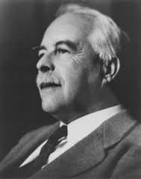
Compounds & electrons are a relatively new discovery!
1916: American chemist Gilbert Newton Lewis proposed that chemical bonds are formed by the electrons
G.N. Lewis observed that elements are most stable when they have 8 valence electrons.
He suggested that atoms bond together to share electrons and complete their valence shells.

Slide 5
Ionic bonding - IONS FORM - ELECTRONS STOLEN
Electrons are completely transferred from one atom to another.
In the process of either losing or gaining negatively charged electrons, the reacting atoms form ions.
The oppositely charged ions are attracted to each other by electrostatic forces, which are the basis of the ionic bond.

Slide 6
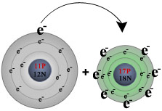
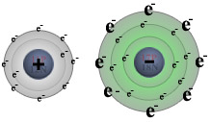
Reaction of sodium with chlorine:
Na
Cl
Na⁺
Cl⁻

Slide 7
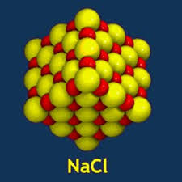
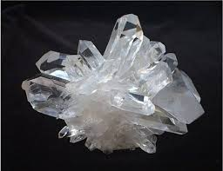
Some facts about ionic bonds:
1. Ionic bonds form between metals and nonmetals.
2. In naming simple ionic compounds, the metal is always first, the nonmetal second (e.g., sodium chloride).
3. Ionic compounds dissolve easily in water and other polar solvents.
4. Ionic compounds tend to form crystalline solids with high melting temperatures.

Slide 8
Covalent bonding - Electrons are shared
Electrons are shared between the atoms
Most common: two nonmetals bond together.
Example: two hydrogen atoms. Atoms of hydrogen (H) have one valence electrons in their first electron shell.
By sharing an electron, they get two!

Slide 9
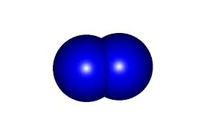
Some facts about covalent molecules
Unlike ionic compounds, covalent molecules are true molecules.
Because electrons are shared in covalent molecules, no ionic charges are formed.
Covalent molecules are not strongly attracted to one another, and so covalent molecules move about freely and tend to exist as liquids or gases at room temperature.

Slide 10
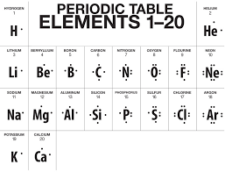
Lewis Dot Structures - show valence electrons

Slide 11
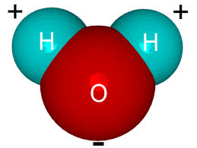
Hydrogen Bonding
A hydrogen bond is the attractive force between a hydrogen atom (low electronegativity) and an atom such as nitrogen, oxygen, or fluorine (high electronegativity)

Slide 12
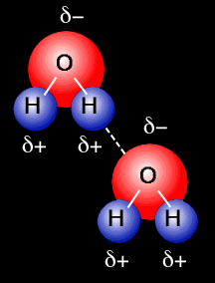
Hydrogen Bonding Example: the water molecule
Oxygen is very electronegative, so it pulls the electron (and their negative charges) towards it’s end of the molecule
Therefore each slightly positive H is attracted to another slightly negative O
Like a “mini” ionic bond!
Watch this video:
http://www.clearbiology.com/water-molecule-worksheet/

Slide 13
Facts about hydrogen bonds
Hydrogen bonds are BETWEEN covalently bonded molecules – very different from ionic and covalent bonds!
Hydrogen bonds are far weaker than ionic or covalent bonds
hydrogen bonding is responsible for the high boiling point of water (100 °C) compared to the other similar molecules that have no hydrogen bonds. Powerful attraction!

