Slide 1
How the heck do I design an experiment?
Let’s figure this out

Slide 2
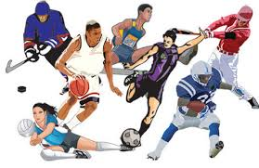
Identify the problem statement or Question
Who has faster reaction times? Gamers or athletes?
Write down your own problem statement or question

Slide 3
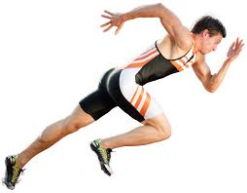
2. Define Variables
Who has faster reaction times? Gamers or athletes?
Type of person
Independent:
Speed of reaction time
Dependent:
Use the same online test
Control:
Write down your own variables

Slide 4
3. Write hypothesis
Who has faster reaction times? Gamers or athletes?
If gamers and athletes reactions times are measured using a computer test, then gamers will have a faster reaction time, because the games they play strengthen their reflexes
Write down your own hypothesis

Slide 5
4. Imagine experiment
Who has faster reaction times? Gamers or athletes?
The experiment should be designed around your variables, time frame, and budget.
5 Gamers and 5 Athletes take an online test, that measures reaction time. The times are collected, and then compared to see who is faster
Write down your own experiment - be realistic!

Slide 6
5. Create a timeline
Who has faster reaction times? Gamers or athletes?
A large project needs short, clear goals
Goal 1: Find online test (do Friday)
Goal 2: Find participants (do over the weekend)
Goal 3: Schedule a time to perform tests (do Monday)
Goal 4: Test participants (do Tuesday)
Write down your own timeline

